Slide 1
Event Loop
Node.js event loop

Slide 2
What is a process?
When we run a program(set of instructions), a process will be created which will further create one or more thread to execute the program.
Each process provides the resources needed to execute a program. A process has a virtual address space, executable code, open handles to system objects, a security context, a unique process identifier, environment variables, a priority class, minimum and maximum working set sizes, and at least one thread of execution. Each process is started with a single thread, often called the primary thread, but can create additional threads from any of its threads.
https://stackoverflow.com/a/200543/9266709

Slide 3
What is a thread?
Thread is a separate execution path. It is a lightweight process that the operating system can schedule and run concurrently with other threads. The operating system creates and manages threads, and they share the same memory and resources as the process that created them. This enables multiple threads to collaborate and work efficiently within a single program.
https://stackoverflow.com/questions/5201852/what-is-a-thread-really
https://www.cs.uic.edu/~jbell/CourseNotes/OperatingSystems/4_Threads.html

Slide 4
Thread Creation
When a thread is created, the operating system must allocate a new thread stack, which is a block of memory that is used to store the thread's local variables, function calls, and other data. The size of the thread stack can vary depending on the platform and the specific requirements of the thread.
In addition to allocating a thread stack, the operating system must also set up the thread's execution context, which includes the thread's program counter, registers, and other state information. This involves copying data from the parent thread's execution context and initializing the new thread's state.
Finally, the operating system must schedule the new thread for execution, which involves adding it to the system's thread pool and assigning it a priority level. This can involve additional overhead, such as locking and unlocking data structures to ensure thread safety.

Slide 5
Every thread must have context that will be used to execute the thread by the processor.
Context:
Register Set registers are small, fast memory locations within the CPU that are used to store temporary data and intermediate results during program execution.
The program counter is a register that contains the memory address of the next instruction to be executed.
The stack pointer is a register that points to the top of the stack, which is a region of memory used to store local variables, function parameters, and return addresses.

Slide 6
Thread States
A Thread can be in one of three states: Waiting, Runnable or Executing.
Waiting: This means the Thread is stopped and waiting for something in order to continue. This could be for reasons like, waiting for the hardware (disk, network), the operating system (system calls) or synchronization calls (atomic, mutexes). These types of latencies are a root cause for bad performance.
Runnable: This means the Thread wants time on a core so it can execute its assigned machine instructions. If you have a lot of Threads that want time, then Threads have to wait longer to get time. Also, the individual amount of time any given Thread gets is shortened, as more Threads compete for time. This type of scheduling latency can also be a cause of bad performance.
Executing: This means the Thread has been placed on a core and is executing its machine instructions. The work related to the application is getting done. This is what everyone wants.

Slide 7
Types Of Work
https://www.ardanlabs.com/blog/2018/08/scheduling-in-go-part1.html
There are two types of work a Thread can do. The first is called CPU-Bound and the second is called IO-Bound.
CPU-Bound: This is work that never creates a situation where the Thread may be placed in Waiting states. This is work that is constantly making calculations. A Thread calculating Pi to the Nth digit would be CPU-Bound.
IO-Bound: This is work that causes Threads to enter into Waiting states. This is work that consists in requesting access to a resource over the network or making system calls into the operating system. A Thread that needs to access a database would be IO-Bound. I would include synchronization events (mutexes, atomic), that cause the Thread to wait as part of this category.

Slide 8
What is the Problem?
Context Switching:
The physical act of swapping Threads on a core is called a context switch.
Context switching involves several steps, including saving the current state of the thread or process, updating the scheduler data structures, selecting a new thread or process to run, restoring the saved state of the new thread or process, and updating the CPU registers.
Context switches are considered to be expensive because it takes times to swap Threads on and off a core. The amount of latency incurrent during a context switch depends on different factors but it’s not unreasonable for it to take between ~1000 and ~1500 nanoseconds. Considering the hardware should be able to reasonably execute (on average) 12 instructions per nanosecond per core, a context switch can cost you ~12k to ~18k instructions of latency. In essence, your program is losing the ability to execute a large number of instructions during a context switch.
If you have a program that is focused on IO-Bound work, then context switches are going to be an advantage. Once a Thread moves into a Waiting state, another Thread in a Runnable state is there to take its place. This allows the core to always be doing work. This is one of the most important aspects of scheduling. Don’t allow a core to go idle if there is work (Threads in a Runnable state) to be done.
If your program is focused on CPU-Bound work, then context switches are going to be a performance nightmare. Since the Thead always has work to do, the context switch is stopping that work from progressing. This situation is in stark contrast with what happens with an IO-Bound workload

Slide 9
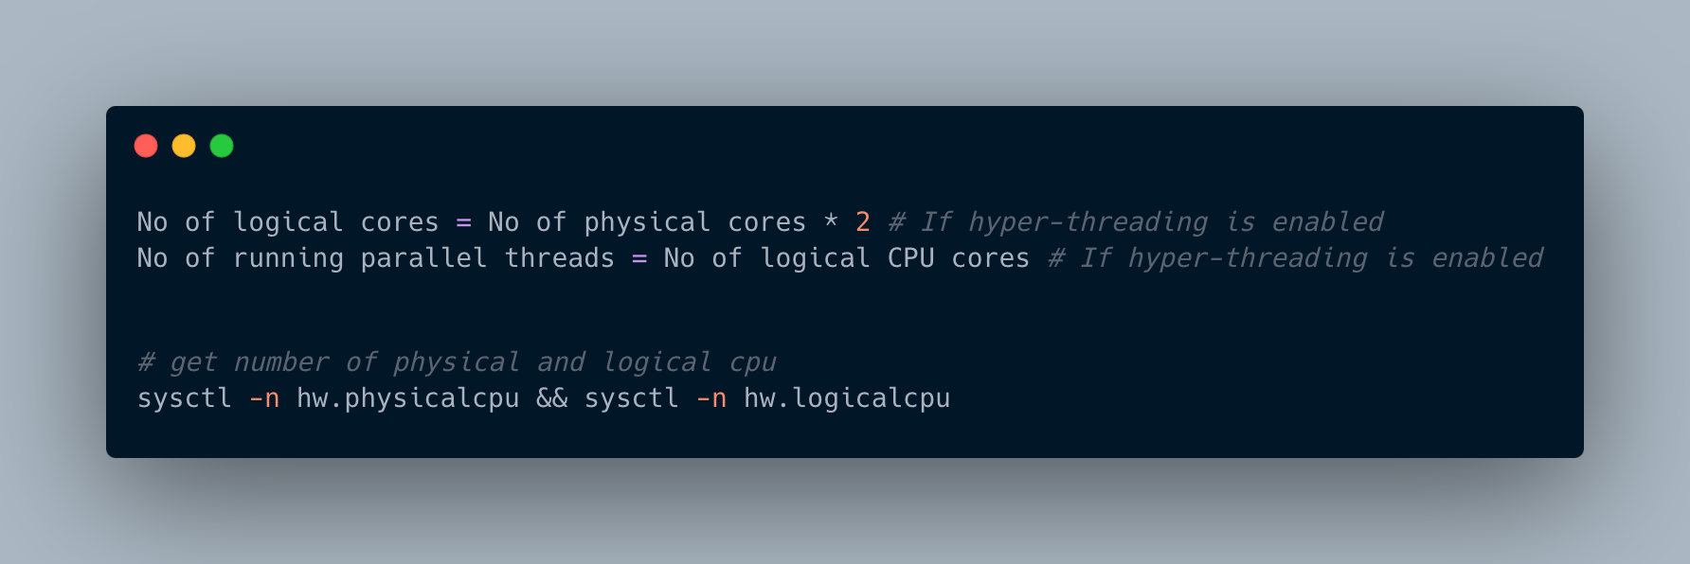
How many thread can be executed parallely concurrently?
A computer with quad physical cores can execute up to four threads in parallel, assuming that each core is capable of executing one thread at a time. However, if hyper-threading is enabled on the CPU, each physical core can execute two threads simultaneously, which would allow up to eight threads to be executed in parallel. https://serverfault.com/questions/1012360/how-can-i-tell-the-maximum-threads-my-server-can-run

Slide 10
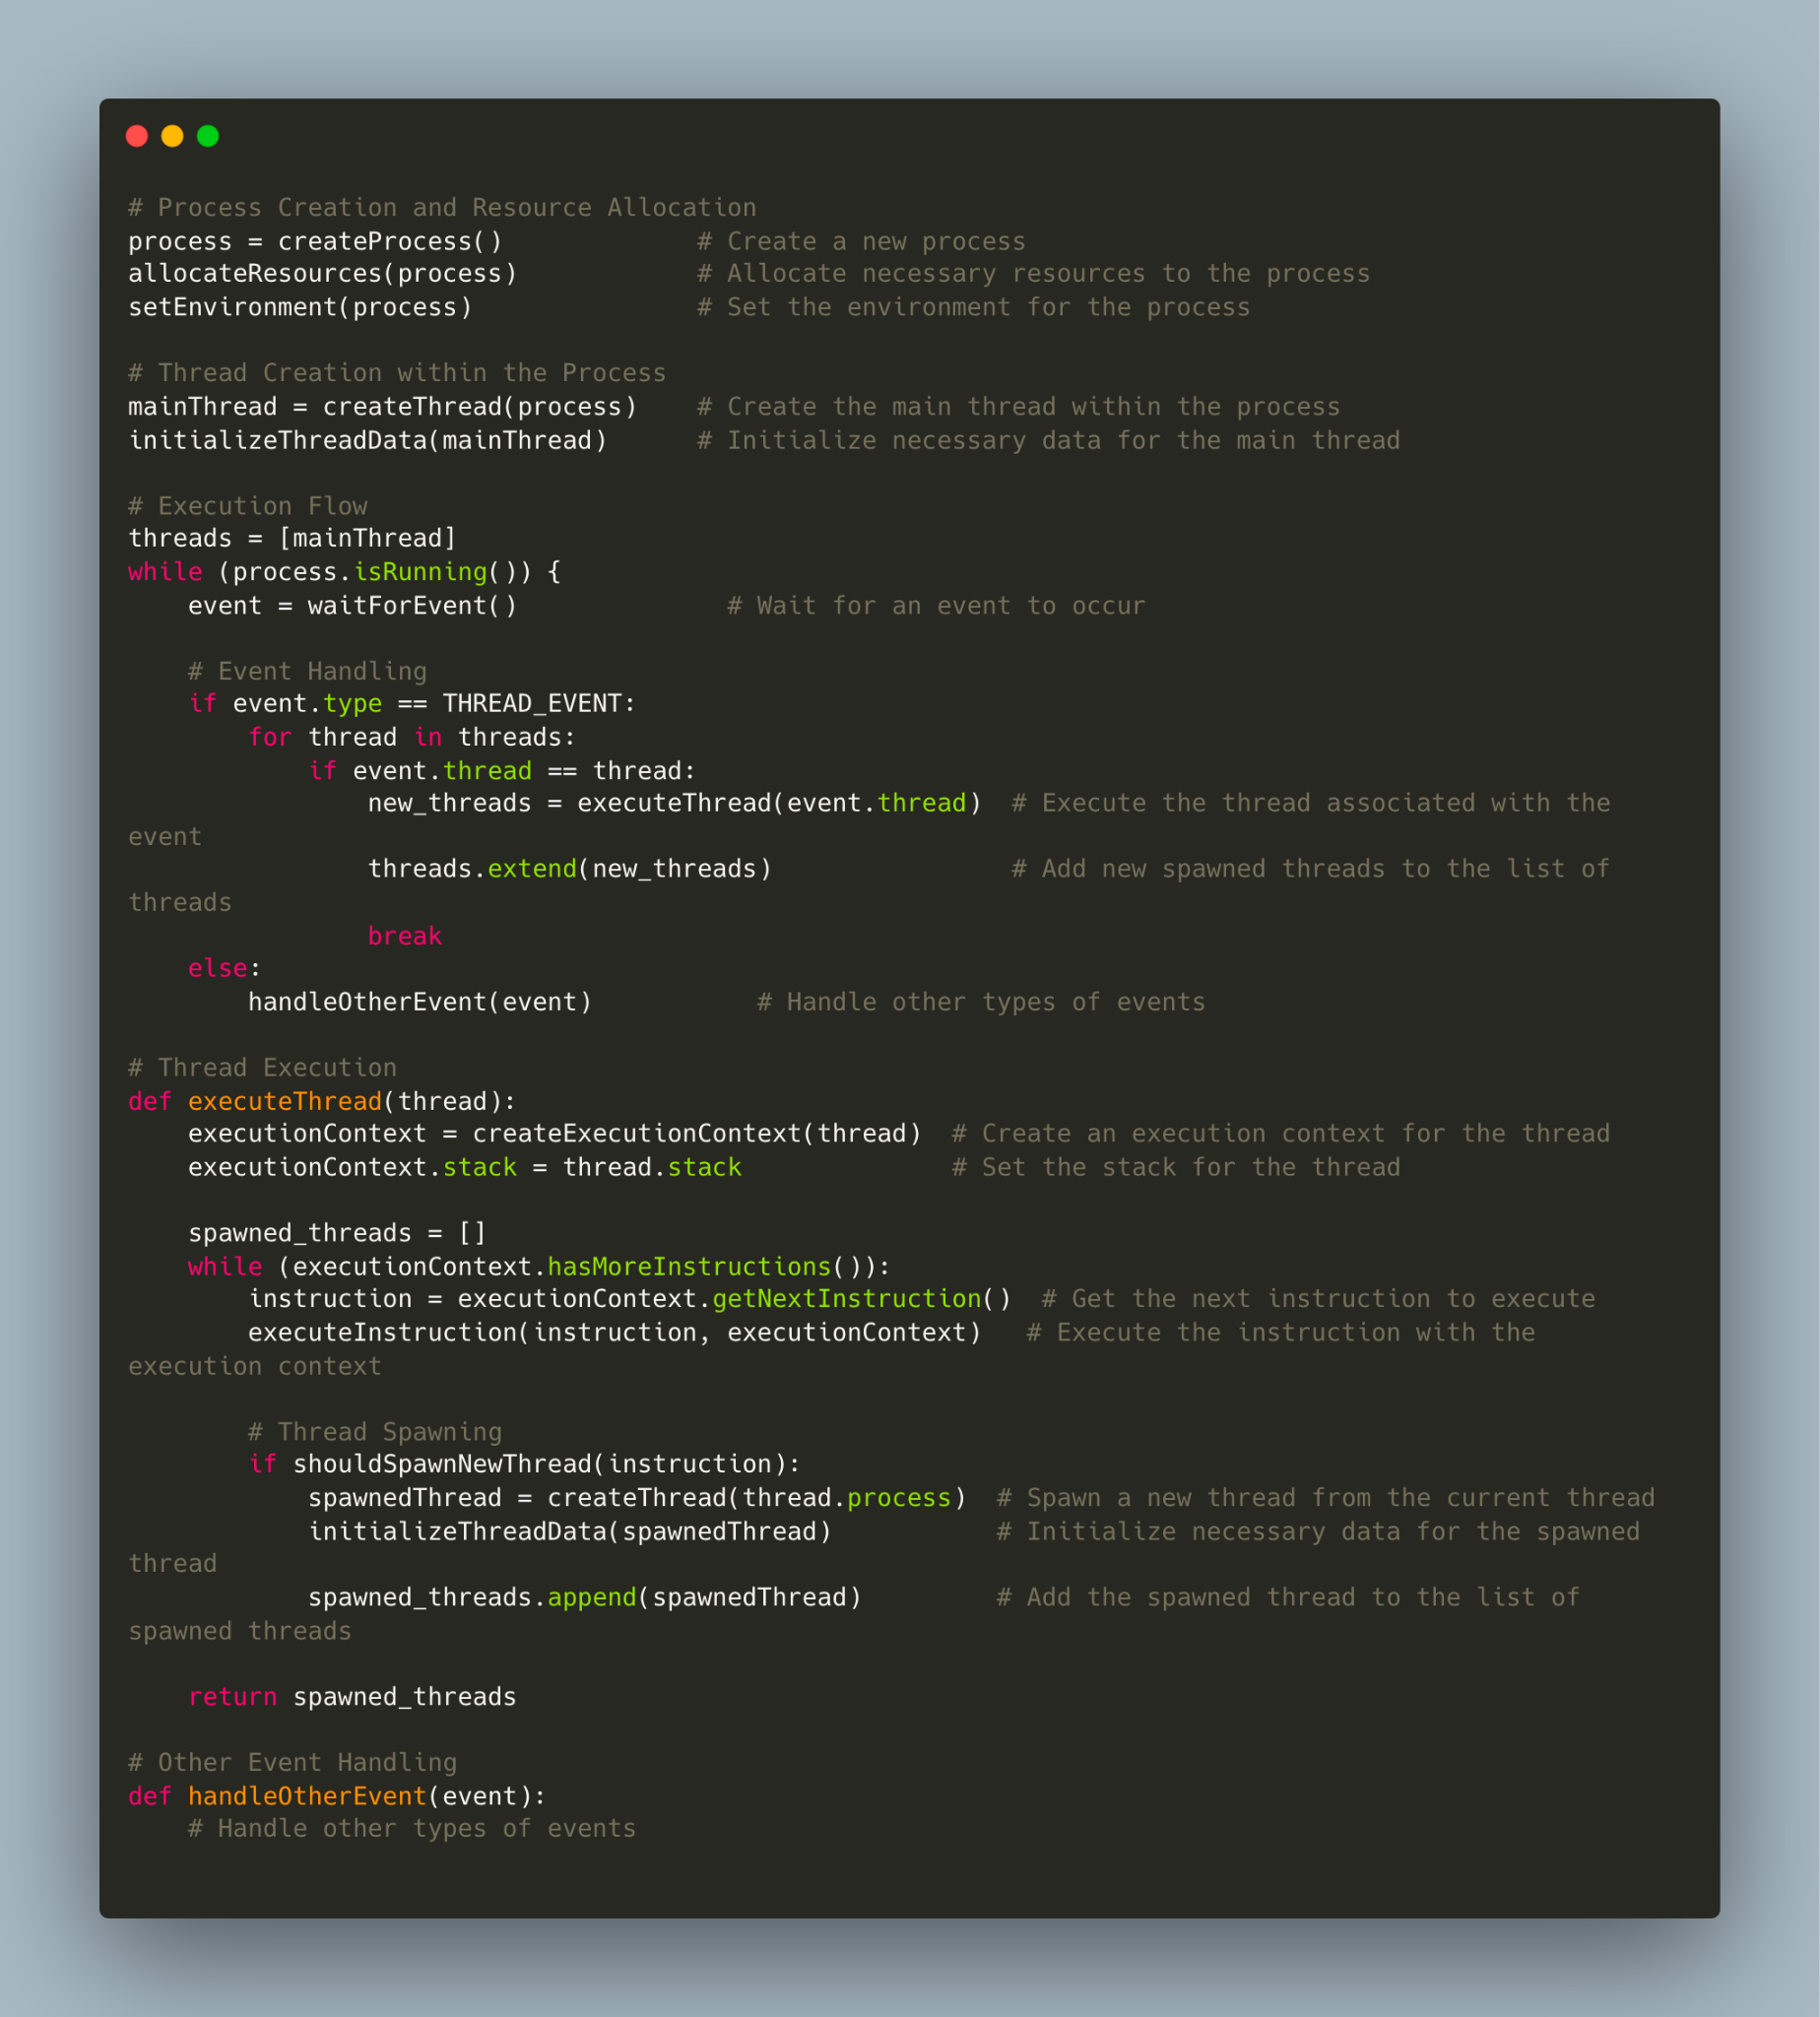

Slide 11
allocateResources(process): This step involves allocating necessary resources to the process. It typically includes allocating memory, file descriptors, and other system resources that the process requires to run. The specific resource allocation may vary depending on the operating system and the requirements of the process.
setEnvironment(process): In this step, the environment for the process is set. The environment typically consists of environment variables, which are key-value pairs that provide configuration and information to the process. These variables can be accessed by the process during its execution.
initializeThreadData(mainThread): This step involves initializing the necessary data for the main thread of the process. It includes setting up the thread's data structures, such as its execution context, stack, thread identifier, and any other thread-specific data. This initialization prepares the main thread for execution.
createExecutionContext(thread): Here, an execution context is created for the given thread. An execution context represents the state of a thread at a specific point in its execution. It includes information such as the program counter, register values, stack pointer, and other necessary data for executing the thread's instructions. The execution context allows the system to switch between threads and resume their execution accurately.

Slide 12
How Operating System can run threads in parallel?
The operating system can run threads in parallel by using a technique called time-sharing or time-slicing. In time-sharing, the CPU is divided into time slices, and each thread is allocated a time slice during which it can execute. The operating system switches between threads at the end of each time slice, allowing multiple threads to run concurrently on a single CPU core.
The operating system uses a scheduler to manage the allocation of time slices to threads. The scheduler assigns priorities to each thread based on factors such as the thread's importance, its I/O requirements, and its CPU usage. The scheduler then allocates time slices to threads based on their priorities, allowing higher-priority threads to execute more frequently than lower-priority threads.

Slide 13
Thread Per Connection - Apache
A new thread is created for each incoming client connection, allowing the server to handle multiple clients concurrently.
Problems:
Resource usage: Creating a new thread for each client connection can consume a significant amount of system resources, including memory and CPU time.
Context switching overhead.
Synchronization: When multiple threads access shared resources, such as data structures or variables, proper synchronization is required to prevent race conditions and other synchronization issues.
Thread management: Managing a large number of threads can be challenging, especially in dynamic environments where the number of client connections can change frequently.

Slide 14
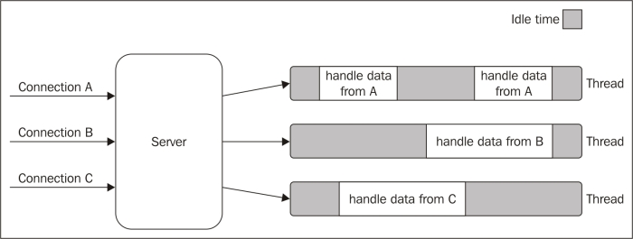

Slide 15
Reactor Pattern
The reactor pattern is a design pattern used in event-driven systems to handle concurrency and asynchronous I/O efficiently.
The key idea behind the reactor pattern is to use a central event demultiplexer and an event loop to manage and dispatch events to their respective handlers.
https://subscription.packtpub.com/book/programming/9781783287314/1/ch01lvl1sec09/the-reactor-pattern
Actual Paper

Slide 16
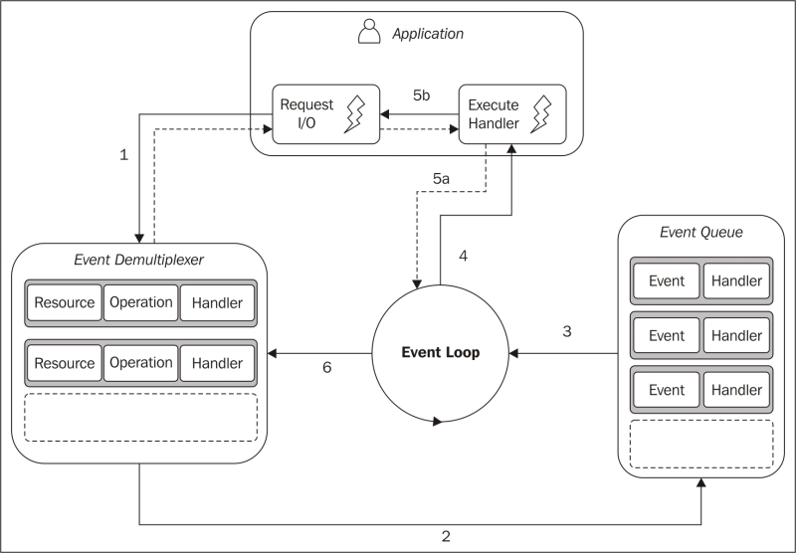

Slide 17
This is what happens in an application using the reactor pattern:
The application generates a new I/O operation by submitting a request to the Event Demultiplexer. The application also specifies a handler, which will be invoked when the operation completes. Submitting a new request to the Event Demultiplexer is a non-blocking call and it immediately returns the control back to the application.
When a set of I/O operations completes, the Event Demultiplexer pushes the new events into the Event Queue.
At this point, the Event Loop iterates over the items of the Event Queue.
For each event, the associated handler is invoked.
The handler, which is part of the application code, will give back the control to the Event Loop when its execution completes (5a). However, new asynchronous operations might be requested during the execution of the handler (5b), causing new operations to be inserted in the Event Demultiplexer (1), before the control is given back to the Event Loop.
When all the items in the Event Queue are processed, the loop will block again on the Event Demultiplexer which will then trigger another cycle.
The asynchronous behavior is now clear: the application expresses the interest to access a resource at one point in time (without blocking) and provides a handler, which will then be invoked at another point in time when the operation completes.

Slide 18
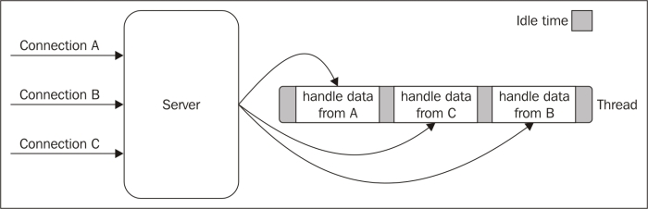

Slide 19
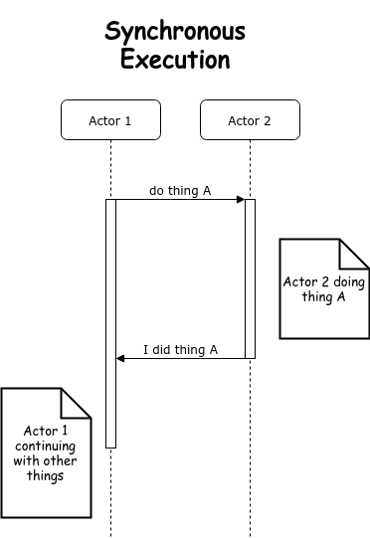
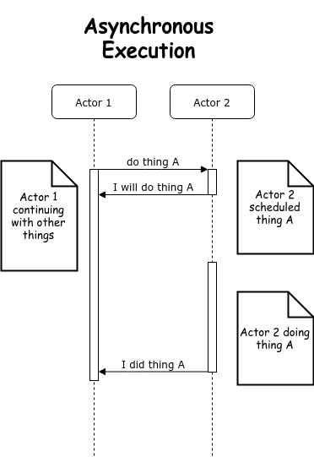

Slide 20
What is Node.js?
It is an asynchronous, event-driven, non-blocking JavaScript runtime.

Slide 21
Overall Flow
Script engine starts execution of the script.
Any time a CPU bound operation is encountered, it is executed inline (real machine), in its completeness.
Any time an I/O bound operation is encountered, the request, and its completion handler are registered with an 'event machinery' (virtual machine)
Repeat the operations in the same manner above until the script ends. CPU bound operation - execute in-line, I/O bound ones, request to the machinery as above.
When I/O completes, the listeners are called back.

Slide 22

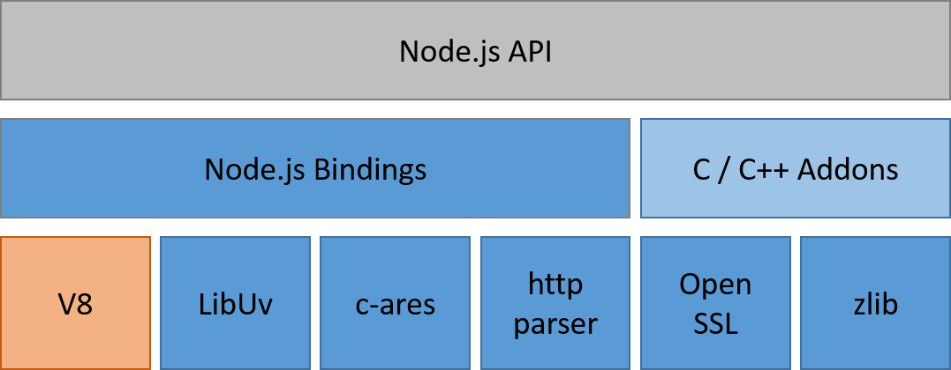
Node.js Components
https://stackoverflow.com/questions/36766696/which-is-correct-node-js-architecture
http://web.archive.org/web/20170208132221/https://arenli.com/architecture-of-node-js-internal-codebase-57cd8376b71f?gi=1984716e61d6

Slide 23

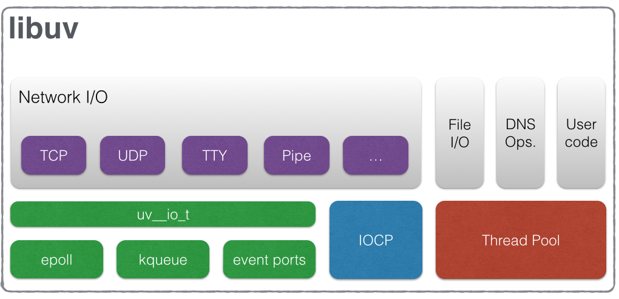
Libuv Architecture for I/O Operations
Crypto and zlib
uv_fs_t
uv_getaddrinfo

Slide 24
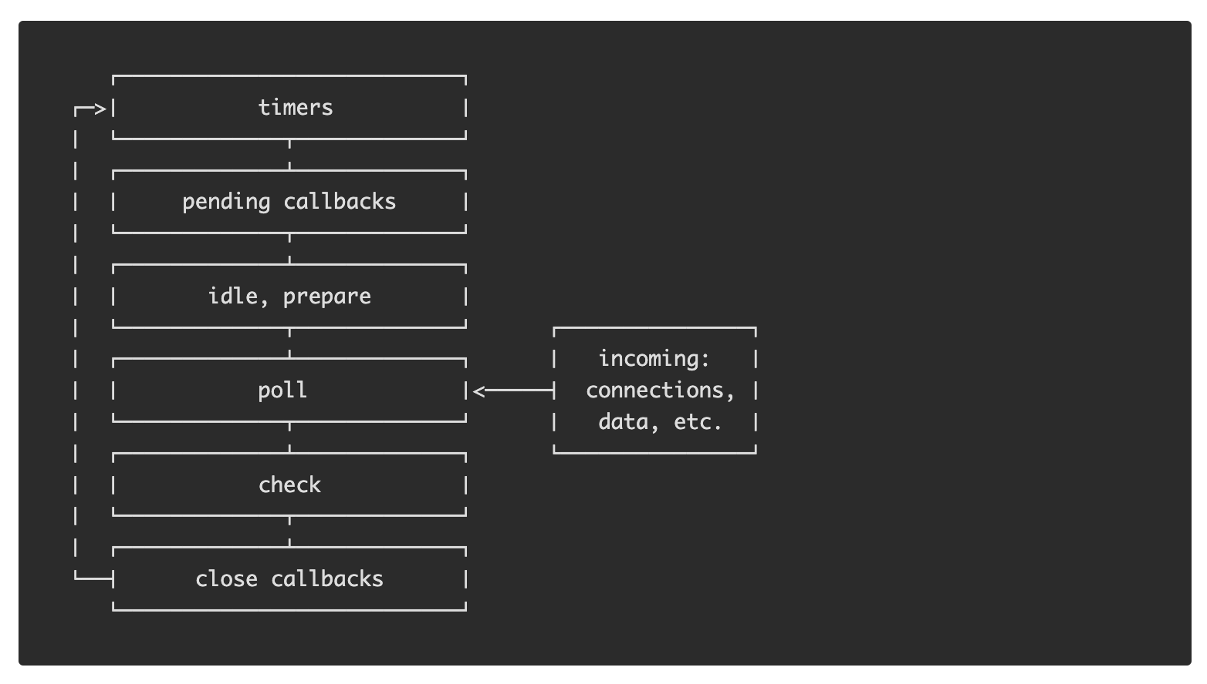
Event Loop Phases
https://nodejs.org/en/docs/guides/event-loop-timers-and-nexttick

Slide 25

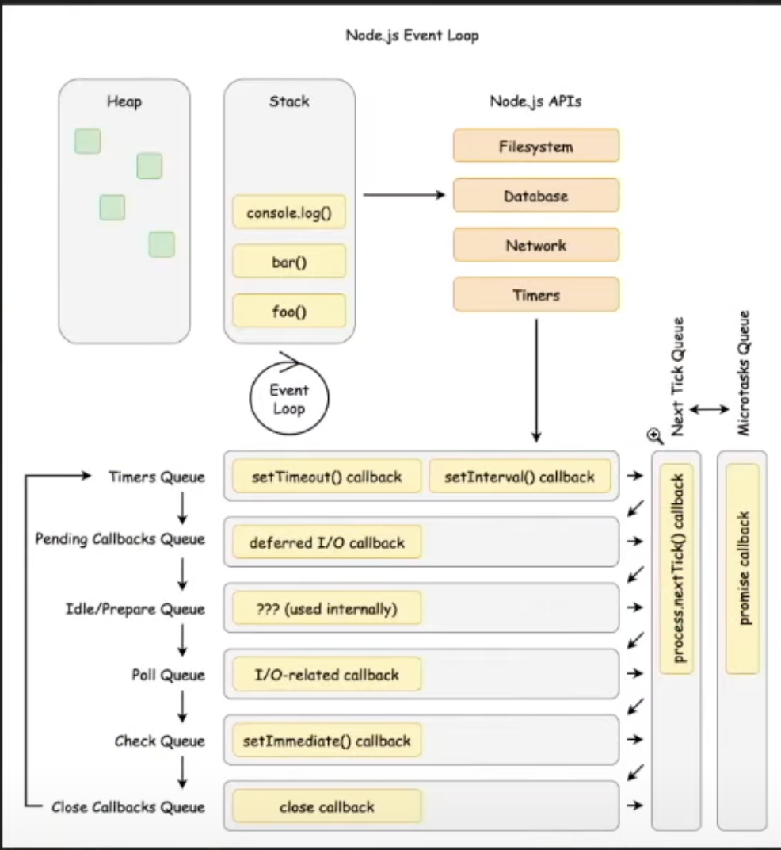

Slide 26
process.nextTick()
All callbacks passed to process.nextTick() will be resolved before the event loop continues.
process.nextTick() will be called as soon as the current executing task completes any phase before moving to the next phase.
The arrows in the previous diagram represent the same

Slide 27
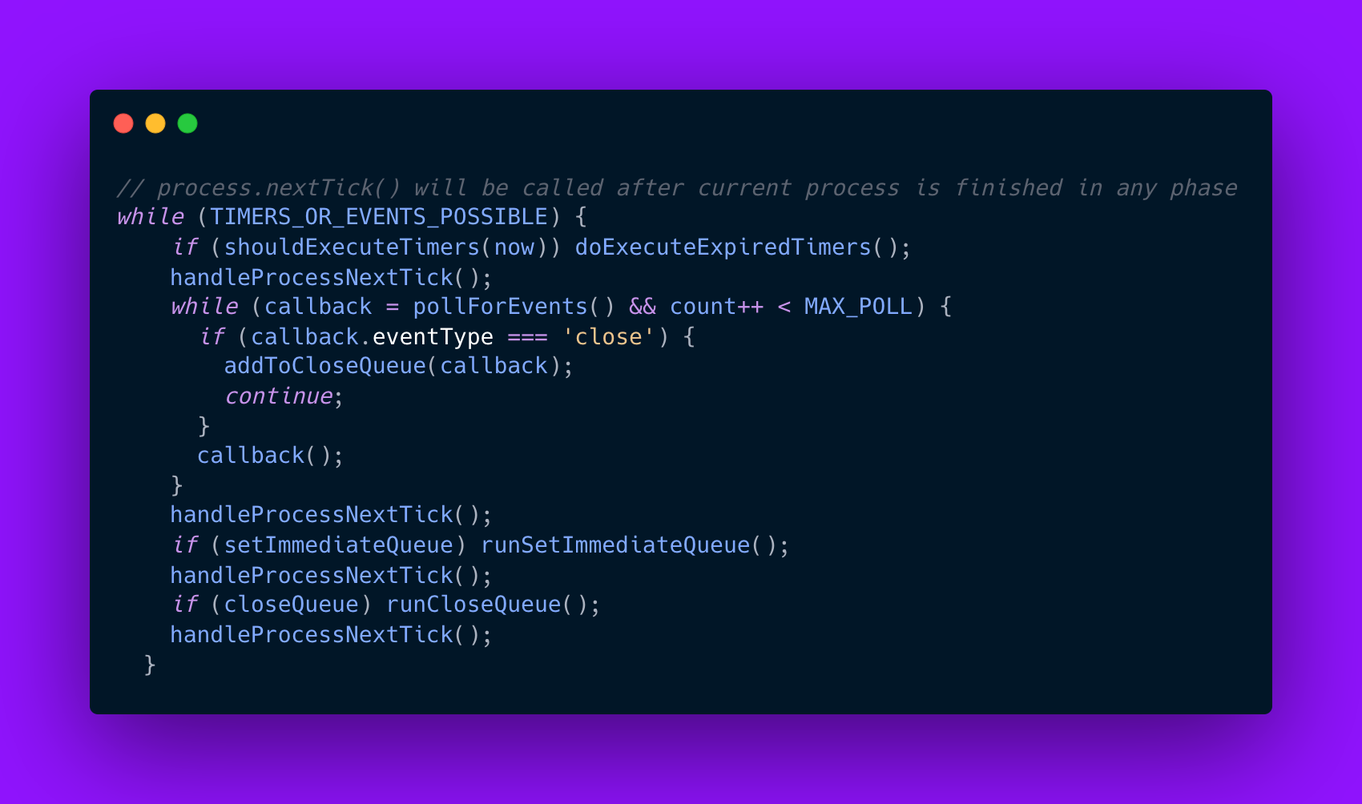

Slide 28
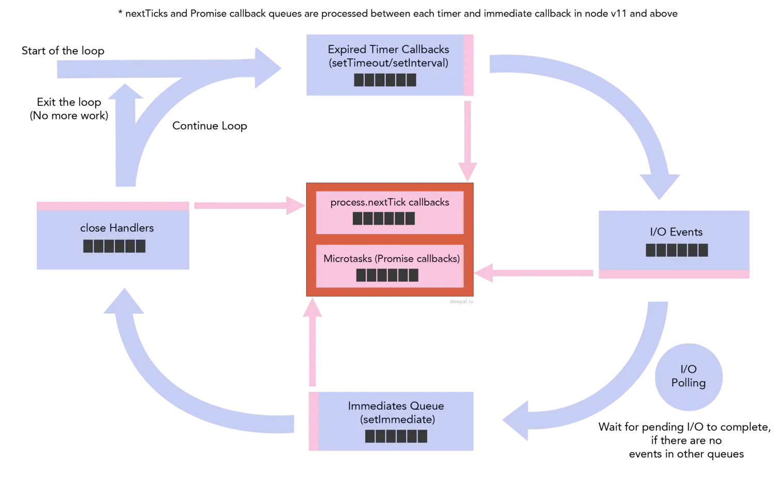

Slide 29

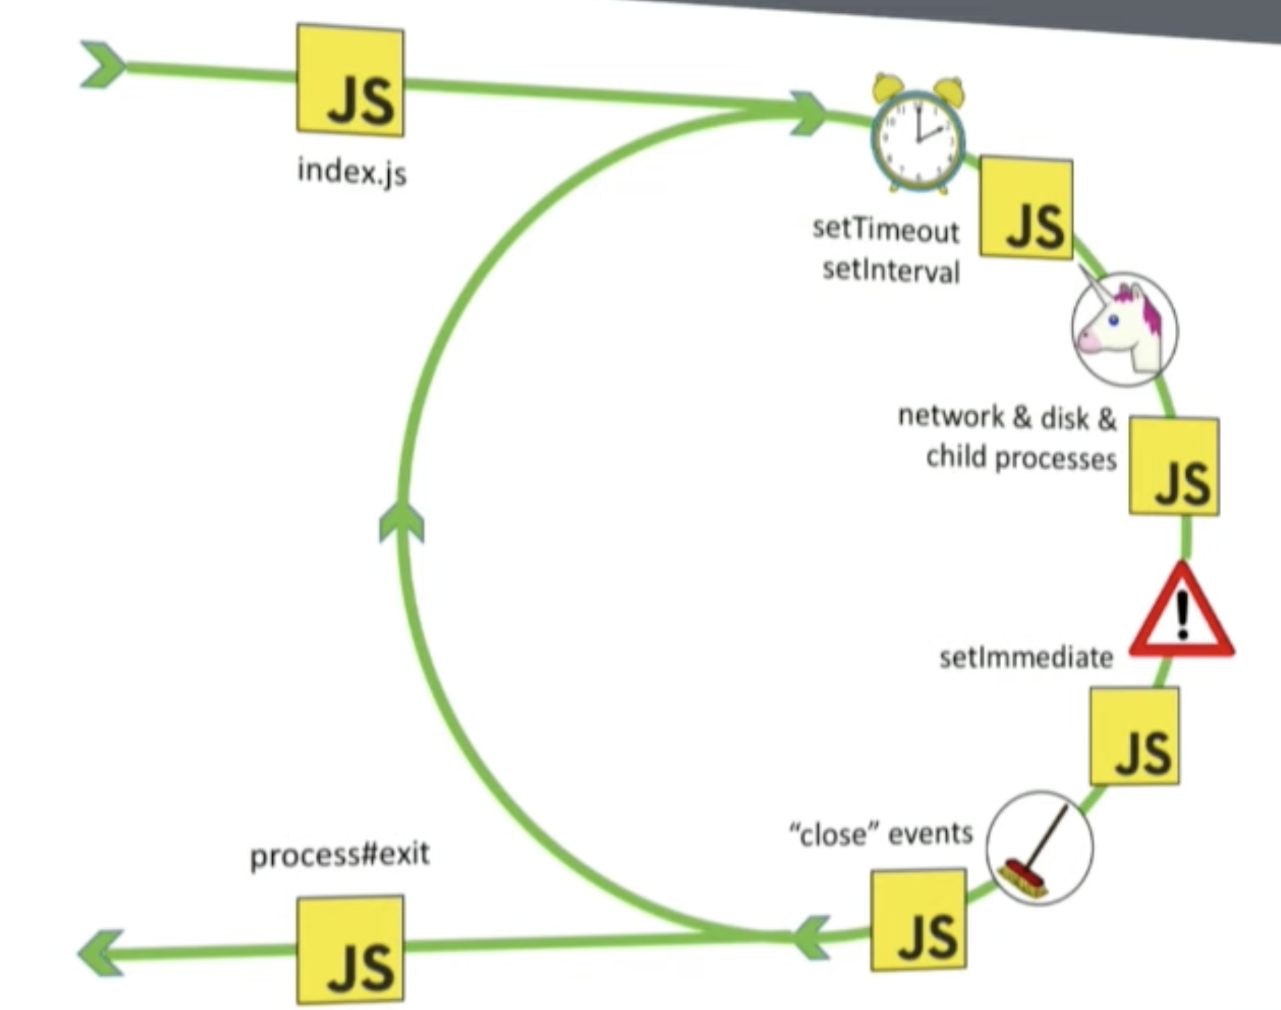
Phases (Event Loop)

Slide 30
`
timers: this phase executes callbacks scheduled by setTimeout() and setInterval().
pending callbacks: executes I/O callbacks deferred to the next loop iteration.
idle, prepare: only used internally.
poll: retrieve new I/O events; execute I/O related callbacks (almost all with the exception of close callbacks, the ones scheduled by timers, and setImmediate()); node will block here when appropriate.
check: setImmediate() callbacks are invoked here.
close callbacks: some close callbacks, e.g. socket.on('close', ...).
https://nodejs.org/en/docs/guides/event-loop-timers-and-nexttick

Slide 31
Timer Phase- setTimeOut()
A timer specifies the threshold after which a provided callback may be executed rather than the exact time a person wants it to be executed. Timers callbacks will run as early as they can be scheduled after the specified amount of time has passed; however, Operating System scheduling or the running of other callbacks may delay them.

Slide 32
Pending Callbacks
In this phase, the event loop in Node.js executes system-related callbacks. Let us say we make a node server and run it on a port, but that port is used by some other process. Node.js will throw an error ECONNREFUSED. Some of the systems may want the callback to wait for completion due to some other tasks that the OS is processing. Thus these callbacks are added to the pending callback queue for execution.

Slide 33
Poll Phase- I/O events and callbacks
Example-1 and example-3
The poll phase has two main functions:
Calculating how long it should block and poll for I/O, then
Processing events in the poll queue.
When the event loop enters the poll phase and there are no timers scheduled, one of two things will happen:
If the poll queue is not empty, the event loop will iterate through its queue of callbacks executing them synchronously until either the queue has been exhausted, or the system-dependent hard limit is reached.
If the poll queue is empty, one of two more things will happen:
If scripts have been scheduled by setImmediate(), the event loop will end the poll phase and continue to the check phase to execute those scheduled scripts.
If scripts have not been scheduled by setImmediate(), the event loop will wait for callbacks to be added to the queue, then execute them immediately.
Once the poll queue is empty the event loop will check for timers whose time thresholds have been reached. If one or more timers are ready, the event loop will wrap back to the timers phase to execute those timers' callbacks.

Slide 34
Check Phase - setImmediate()
This phase allows a person to execute callbacks immediately after the poll phase has completed. If the poll phase becomes idle and scripts have been queued with setImmediate(), the event loop may continue to the check phase rather than waiting.

Slide 35
Close Phase
If a socket or handle is closed abruptly (e.g. socket.destroy()), the 'close' event will be emitted in this phase. process.exit() or socket.on('close', fn).

Slide 36
setImmediate() vs setTimeout()
Example-4 and example-5
setImmediate() and setTimeout() are similar, but behave in different ways depending on when they are called.
setImmediate() is designed to execute a script once the current poll phase completes.
setTimeout() schedules a script to be run after a minimum threshold in ms has elapsed.

Slide 37
Poll Phase
https://www.geeksforgeeks.org/what-is-poll-phase-in-node-js-event-loop/
https://github.com/nodejs/help/issues/1118 - Please go through whole at least once

Slide 38
Resources
https://www.youtube.com/watch?v=PNa9OMajw9w&t=125s
https://www.youtube.com/watch?v=sGTRmPiXD4Y
https://www.youtube.com/watch?v=P9csgxBgaZ8&t=604s
https://stackoverflow.com/questions/64264617/when-is-process-nexttick-in-the-nodejs-event-loop-called
https://stackoverflow.com/questions/56622353/how-does-reactor-pattern-work-in-node-js
https://stackoverflow.com/questions/50718543/node-js-how-libuv-thread-pool-works

Slide 39
Open Questions
Why there is inconsistency in the execution order of setTimout and setImmediate ?
https://nodejs.org/en/docs/guides/event-loop-timers-and-nexttick#setimmediate-vs-settimeout
What makes node.js more efficient compared to a server model that uses one thread per connection when, in the end, the operating system (OS) is responsible for creating and managing those threads as well?
Node.js does not create individual threads for each connection hence having much less threads, and it does not manage those threads. Instead, it hands over I/O tasks to the operating system (OS) to leverage its internal mechanism for efficient handling.
Node.js optimizes the handling of user requests without reducing the CPU load. Read More

Slide 40
Open Question
Drop your questions below or discuss here
??

